Slide 2
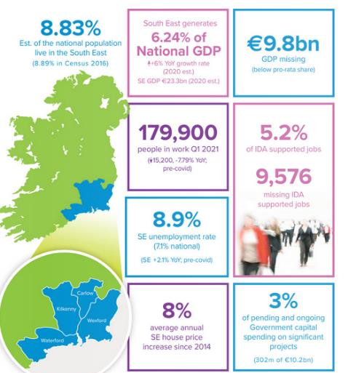
RG
5th ed. (since 2016)
Independent academics
Highest academic standards
Wide impact
All opinions expressed are those of the authors and do not represent those of WIT
Prepared by:
Dr Cormac O’Keeffe, Lecturer in Finance
Dr Ray Griffin, Lecturer in Strategy
John Casey, Lecturer in Accounting
Notes:
Thanks for the invite- appreciate the engagement. 3rd time presenting to Waterford Council, also presented to KK and WX- important forum for our work.
Sat out last year- 3 drafts, data all over the place.
Independent of WIT
Wide circulation amongst Irish economics community, politics, broad community & business/industry stakeholders

Slide 3
Today’s agenda
RG
Economic update
SE returns to growth on back of dramatic national growth
Relative gap persists
Labour market update
Lower participation/higher unemployment/low job quality
IDA regional strategy has failed, massive deficit, IDA now acknowledging this to Govt.
Ireland2040 observations
National spending of €10bn indicative of ~€200m in SE
No significant projects in active development
Education capacity
No evidence of commitment to resolving HE capacity issue, brain drain persists
An unfunded TU not a solution, significant operational risks
Health observations
Model 4 deficit, awaiting hospital grouping redesignation with trepidation
Final comments
Place large projects on care & maintenance footing and return to micro-projects until more favourable national situation.
Notes:
COVID & Brexit impacts washing through

Slide 4
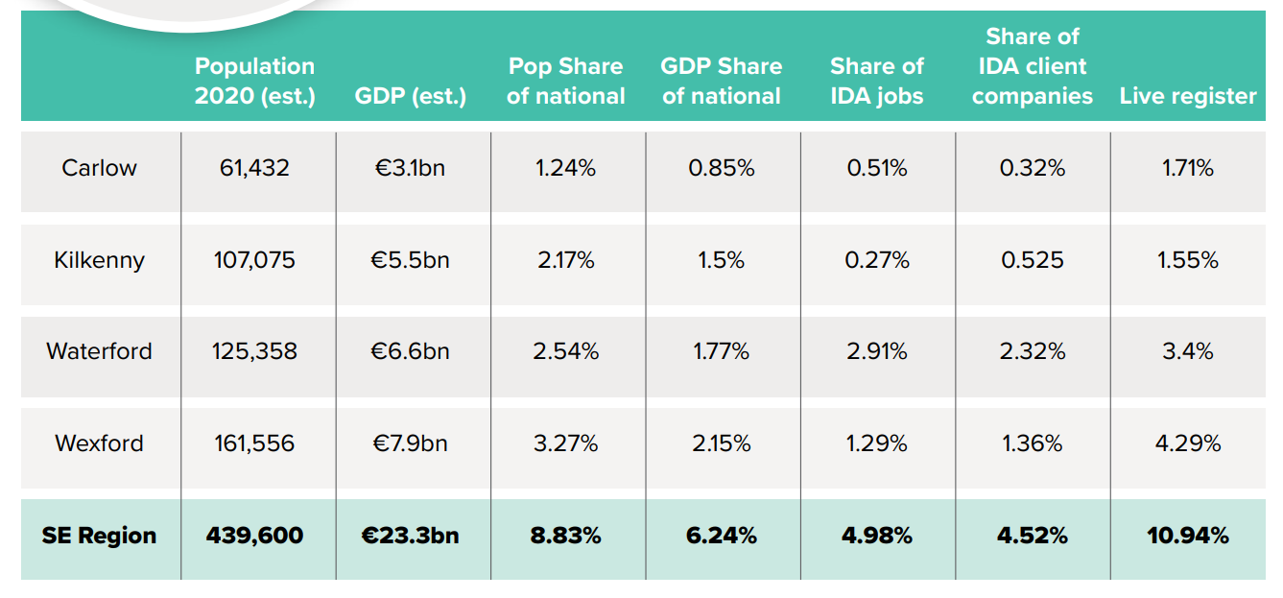
Region at a glance
RG
Notes:
GDP -70% national avg (WD 91%)
IDA 56% of national avg of jobs

Slide 5
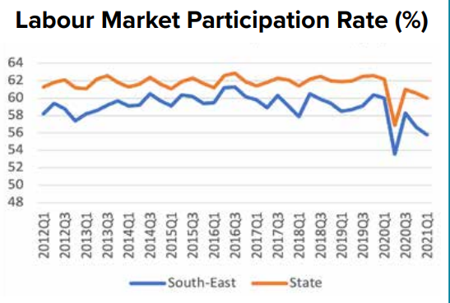
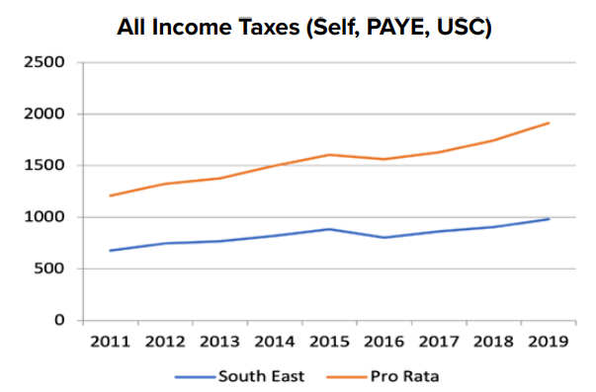
Labour Market
CO’K
In Employment | In Employment
South-East | 193,300 (↑10.2% Y-o-Y)
State | 2,349,100 (↑9.9% Y-o-Y)
Notes:
3 graphs SE v state
In employment thousands: Growth in last three years flat and a long way behind state growth rate (1.5 v 4.4%)
Unemployment rate: 2021 Q2 – 8.8% v State 7.3% (gap persistently above 1% target).
Participation rate: 2021 Q2 – 59.9% v State 63.1%
Income tax returns: 51.2% of national average
Story
Employment broadly stagnant over the past few years- 180-195k… now at high mark, would be nice to see it break thru 200k
Unemployment rate structural gap
Participation rate structural gap
Job quality poor…
So unstressed LM, lots of capacity, big structural gap with rest of country

Slide 6
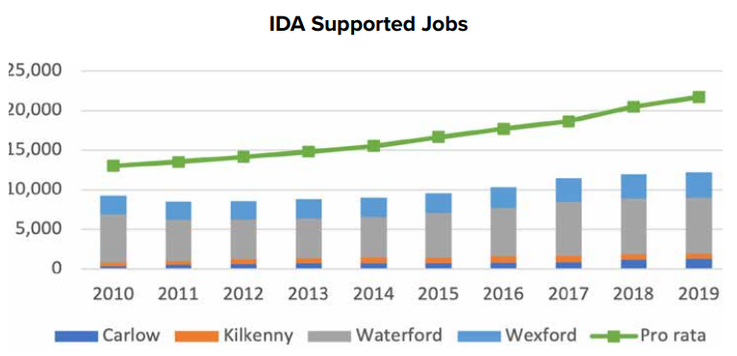
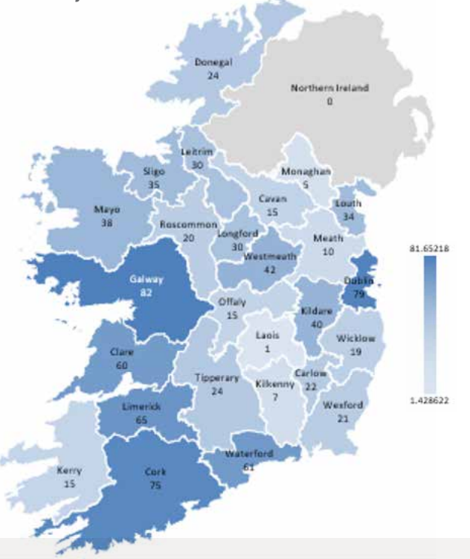
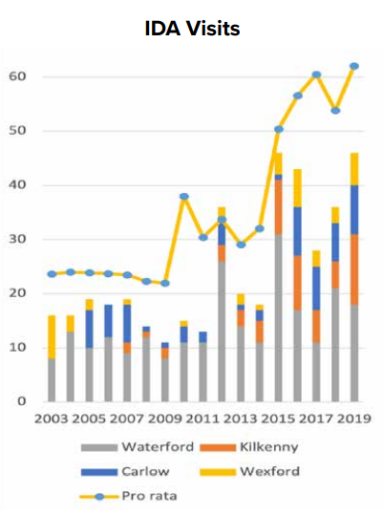
IDA
CO’K
Notes:
National IDA job growth of 6% versus only 1.6% in SE – gap widening.
Region with 8.9% of population has 5% (4.5%) of IDA-supported jobs (companies).
Deficit has more than doubled over the last decade -> €632m of direct payroll lost.
Visits continue to fall short – 195 missing between 2003 and 2019.
Enterprise Ireland is keeping pace and delivering for the region.
High Unemployment
SE 8.8% Nationally 7.3% (CSO, Q2-21)
SE 8.9% Nationally 7.1% (CSO, Q1-21)
Low Job Quality
Disposable income 93.5% of National Avg.
Gross value added 67% of National Avg. (CSO,2014)
Income tax 51% of National Avg.
High Deprivation
Disposable income 93.5% of National Avg.
Gross value added 67% of National Avg.
Rising poverty levels (at risk, deprivation, consistent measures) (CSO,2014).
In Ireland, 11 basic items are used to construct the deprivation index:
• Unable to afford two pairs of strong shoes
• Unable to afford a warm waterproof overcoat
• Unable to afford new (not second-hand) clothes
• Unable to afford a meal with meat, chicken or fish (vegetarian equivalent) every second day
• Unable to afford a roast joint or its equivalent once a week
• Without heating at some stage in the last year through lack of money
• Unable to afford to keep the home adequately warm
• Unable to afford to buy presents for family or friends at least once a year
• Unable to afford to replace any worn out furniture Unable to afford to have family or friends for a drink or meal once a month
• Unable to afford a morning, afternoon or evening out in the last fortnight for entertainment

Slide 7
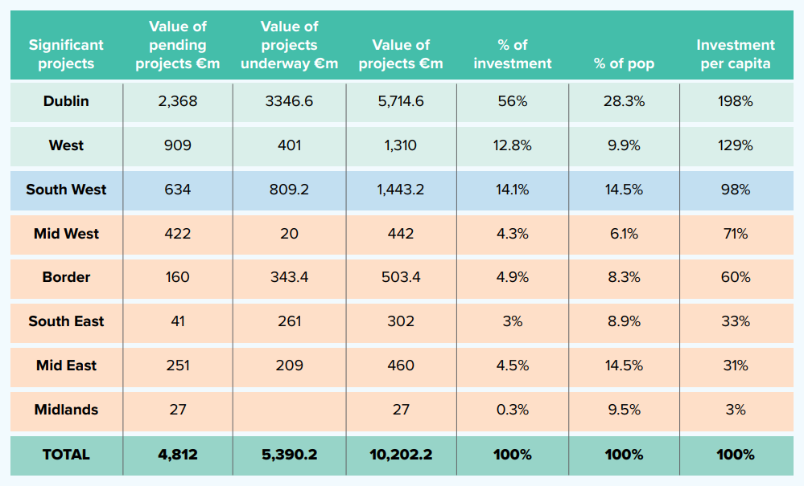
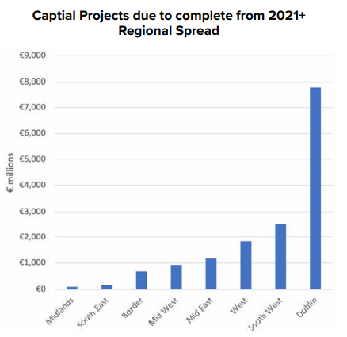
Ireland2040
JC
Ireland 2040
Balanced regional development
‘Regional’ is mentioned 230 times in the National Development Plan 2021-2030
Dublin appears to be receiving a disproportionate share; inconsistent with economic policy
Notes:
High Unemployment
SE 8.0% Nationally 6.9% (CSO, Q3-17)
SE 8.6% Nationally 6.9% (CSO, Q2-17)
Low Job Quality
Disposable income 93.5% of National Avg.
Gross value added 67% of National Avg. (CSO,2014)
Income tax
High Deprivation
Disposable income 93.5% of National Avg.
Gross value added 67% of National Avg.
Rising poverty levels (at risk, deprivation, consistent measures) (CSO,2014).
In Ireland, 11 basic items are used to construct the deprivation index:
• Unable to afford two pairs of strong shoes
• Unable to afford a warm waterproof overcoat
• Unable to afford new (not second-hand) clothes
• Unable to afford a meal with meat, chicken or fish (vegetarian equivalent) every second day
• Unable to afford a roast joint or its equivalent once a week
• Without heating at some stage in the last year through lack of money
• Unable to afford to keep the home adequately warm
• Unable to afford to buy presents for family or friends at least once a year
• Unable to afford to replace any worn out furniture Unable to afford to have family or friends for a drink or meal once a month
• Unable to afford a morning, afternoon or evening out in the last fortnight for entertainment

Slide 8
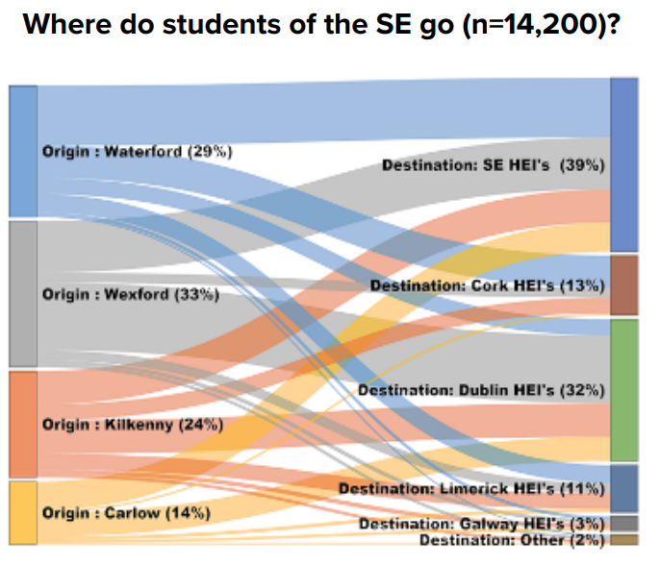
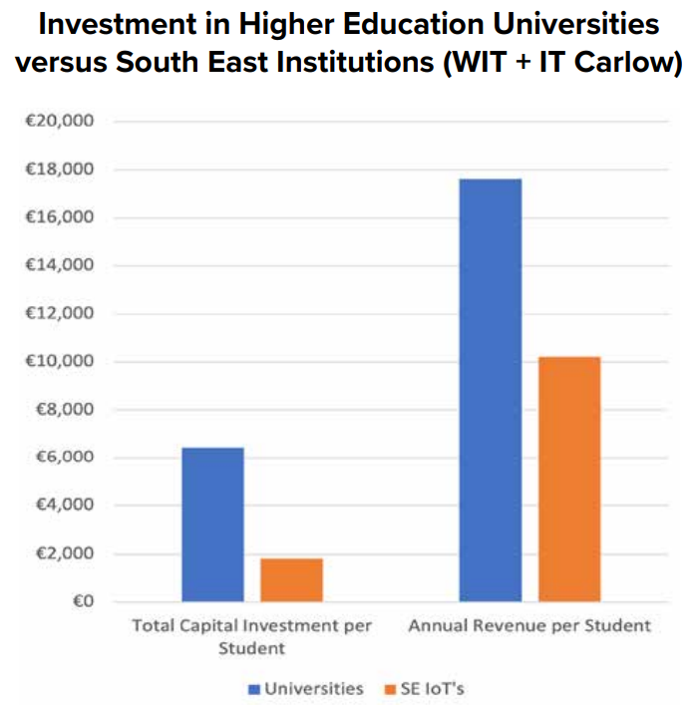
Education
JC
Many students leave the region for HE (Do they return? What is the economic cost?)
The traditional university sector is funded to a much greater extent.
This puts the SE IoT’s at a permanent disadvantage
Funding model for TU’s is unresolved
Notes:
High Unemployment
SE 8.0% Nationally 6.9% (CSO, Q3-17)
SE 8.6% Nationally 6.9% (CSO, Q2-17)
Low Job Quality
Disposable income 93.5% of National Avg.
Gross value added 67% of National Avg. (CSO,2014)
Income tax
High Deprivation
Disposable income 93.5% of National Avg.
Gross value added 67% of National Avg.
Rising poverty levels (at risk, deprivation, consistent measures) (CSO,2014).
In Ireland, 11 basic items are used to construct the deprivation index:
• Unable to afford two pairs of strong shoes
• Unable to afford a warm waterproof overcoat
• Unable to afford new (not second-hand) clothes
• Unable to afford a meal with meat, chicken or fish (vegetarian equivalent) every second day
• Unable to afford a roast joint or its equivalent once a week
• Without heating at some stage in the last year through lack of money
• Unable to afford to keep the home adequately warm
• Unable to afford to buy presents for family or friends at least once a year
• Unable to afford to replace any worn out furniture Unable to afford to have family or friends for a drink or meal once a month
• Unable to afford a morning, afternoon or evening out in the last fortnight for entertainment

Slide 9
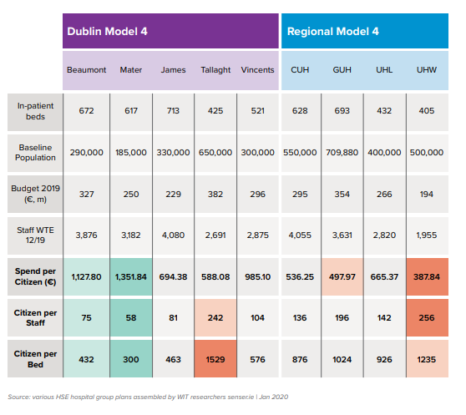
Health
RG
Notes:
High Unemployment
SE 8.0% Nationally 6.9% (CSO, Q3-17)
SE 8.6% Nationally 6.9% (CSO, Q2-17)
Low Job Quality
Disposable income 93.5% of National Avg.
Gross value added 67% of National Avg. (CSO,2014)
Income tax
High Deprivation
Disposable income 93.5% of National Avg.
Gross value added 67% of National Avg.
Rising poverty levels (at risk, deprivation, consistent measures) (CSO,2014).
In Ireland, 11 basic items are used to construct the deprivation index:
• Unable to afford two pairs of strong shoes
• Unable to afford a warm waterproof overcoat
• Unable to afford new (not second-hand) clothes
• Unable to afford a meal with meat, chicken or fish (vegetarian equivalent) every second day
• Unable to afford a roast joint or its equivalent once a week
• Without heating at some stage in the last year through lack of money
• Unable to afford to keep the home adequately warm
• Unable to afford to buy presents for family or friends at least once a year
• Unable to afford to replace any worn out furniture Unable to afford to have family or friends for a drink or meal once a month
• Unable to afford a morning, afternoon or evening out in the last fortnight for entertainment

Slide 10
Why is the SE not thriving?
RG
7,260 8,686 Missing Higher Education Places
Unemployment Crisis and Low Job Quality
IDA
Education
6,312 9,576 Missing IDA-Supported Jobs
13 18 Years of Stagnation
Notes:
Lack of IDA activity (not beating up on IDA regional office, National policy direction) 6,312 started this
Lack of Higher Education Capacity 7,260, now 8,686
Stagnation maybe lifting in GDP growth… but the economy is not thriving like the rest of Ireland

Slide 11
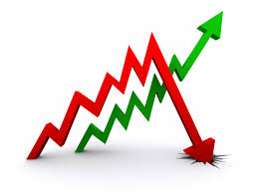
Reflections
RG
Gap between region & state continues to widen
All significant measures to address this are in difficulty
Private capital refuses to go where Govt. will not
Perhaps revert to S/M project approach as L/XL approach has no national traction

Slide 12
Thank you
Prepared by:
John Casey, Lecturer in Accounting, Dept. of Accountancy and Economics, WIT T. 353(0)51 302425 | E. jcasey@wit.ie
Dr Ray Griffin, Lecturer in Strategy, Dept. of Management and Organisation, WIT T. 353(0)51 302465 | E. rgriffin@wit.ie
Dr Cormac O’Keeffe, Lecturer in Finance, Dept. of Accountancy and Economics, WIT T. 353(0)51 845607 | E. cokeeffe@wit.ie

