Slide 1

Healthy Age Friendly Homes Programme
Aoife McGrath
Regional Programme Manager,
South-East Region
Kevin Moynihan
Local Coordinator,
Waterford City & County

Slide 2
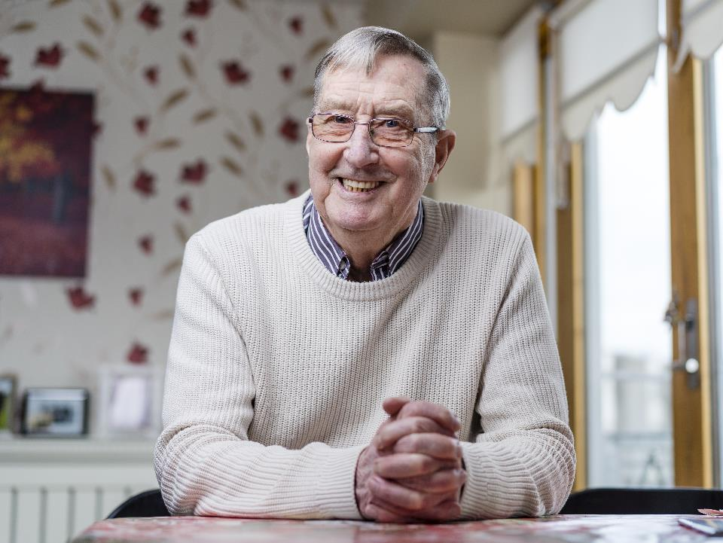
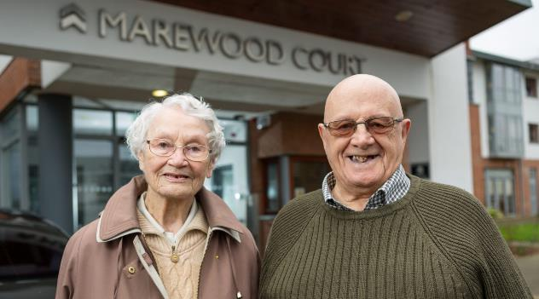
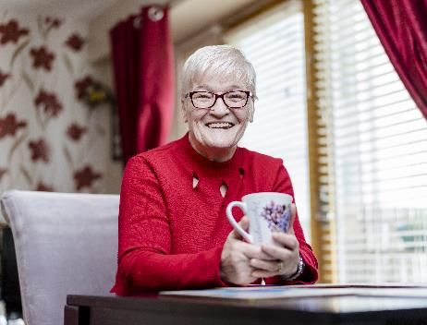
Who We Support…
Notes:
PROGRAMME FOR PERSONS OVER THE AGE OF 65 HOWEVER
WE HAVE VISITED YOUNGER PARTICIPANTS BASED ON NEEDS AND SUPPORTS

Slide 3
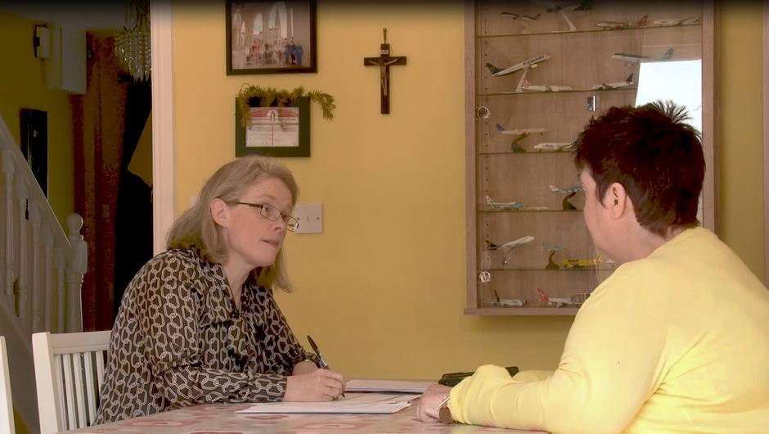
The Home Visit…
Image 8
Notes:
VISIT THE HOME OF THE OLDER PERSON CARRY OUT A NEEDS ASSESSMENT
THIS IS ANN AND ROSALEEN IN THE PICTURE
ASSESMENT TAKES 1HR TO 1.5HRS

Slide 4




What can we help with?
HOUSING
Future Proofing
Housing Adaptation Grants
Rightsizing
Care and Repair
Home sharing
COMMUNITY
Social activities
Befriending
Community groups
Libraries
Community | Social
Housing
TECHNOLOGY
Personal alarms
Panic Buttons
Digital training
Connectivity
MEDICAL / HEALTH
Home Help
Access to Physiotherapy
Access to Occupational Therapy
GP Visits
Medical | Health
Technology
CLIMATE/ENERGY
Grant information
BER Home Energy Assessments
FINANCIAL
Accessing Allowances
Carers Supports
Pension information
Bills Advice
Energy | Climate
Finance

Slide 5






Role of the Co-Ordinator
There is NO limit on the amount of visits a Coordinator does per person
Providing Information
Signposting to supports
Facilitative processes “handholding”
Implement Actions
Track Progress
Enable & Empower Older People

Slide 6

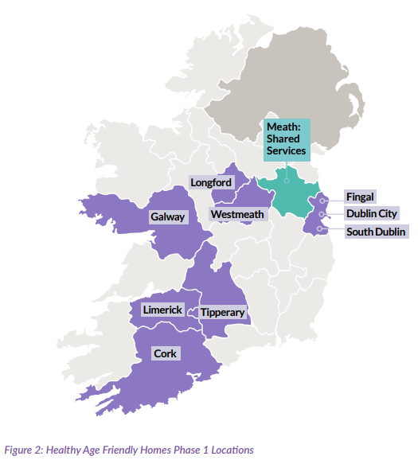
National Rollout
44 Local Coordinators across 31 Local Authorities
6 Regional Managers
16 Admin Support Team based in our Shared Service Offices in Meath
44
9
South East– 9 Coordinators
DLR- 2
Wicklow -1
Carlow – 1
Wexford – 2
Kilkenny – 1
Tipperary South – 1
Waterford – 1

Slide 7

Healthy Age Friendly Homes | Programme Delivery
Waterford City & County: Programme Dashboard 2024-2025
Waterford City & County:
441no. Referrals Received (Jan 2024-May 2025)
441
Total Referrals Received
(Jan 2024-May 2025)
88
Referrals Received
(Jan 2025-May 2025)
97yrs
Oldest Waterford Participant
of the Programme
Data Extract Date: 09th June 2025

Slide 8
Healthy Age Friendly Homes | Programme Delivery
Waterford City & County (Programme Commencement: Apr 2024)
Initial Visits & Additional Visits
(Apr 2024 - May 2025)
Combined Total Visits
(Apr 2024 - May 2025)
261
Total Visits
(Apr 2024-Dec 2024)
146
Total Visits
(Jan 2025-May 2025)
Data Extract Date: 09th June 2025

Slide 9
Healthy Age Friendly Homes | Programme Delivery
Waterford City & County: Programme Dashboard 2024-2025
Breakdown of Supports Offered (To-Date)
1,161
Total
Support Actions
96
Age of Oldest Participant
99
Participants in referred into Programme are 90+ yrs
28%
Support Actions are
Housing-Related
Of 330no. Housing-Related Grants Incl:
Housing Adaptation Grants (45%)
Housing Aid for Older People (1%)
Mobility Aid Grants (1%)
Privately Funded Housing Adaptations (1%)

Slide 10





CONTACT US
ADDRESS
Phone Number
Kells Civic Office, Headfort Place, Kells, Co Meath, A82 W2R3
(046) 924-8899
HOURS
FACEBOOK
Mon-Fri 9AM to 5PM Weekends closed
@Age Friendly Ireland
E-MAIL
TWITTER
healthyagefriendlyhomes@meathcoco.ie
@AgeFriendlyIrl
WEBSITE
WEBSITE
www.agefriendlyireland.ie
www.agefriendlyhomes.ie

